Slide 1


Fast medication automation
Team Rolex
Bojana Chen
Sebastian Fernandez
Magdalena Hardegger
Gerardo Romeny
Team-Project DigitaliZation of Business Processes, AS 2023
Picture:. https://www.freepik.com/free-photo/packings-pills-capsules-medicines_1178867.htm#query=medication&position=6&from_view=search&track=sph&uuid=e8115ce7-5bd6-4dc1-b773-868d6d0d55f9">Image by topntp26

Slide 2

Problem: Prescription handling
Medication errors are numerous
Adverse events owing to medication: about 20 000 hospitalizations/year in Switzerland
Increasing: - number of medications
- drug interactions
- healthcare costs
Picture: von Unbekannter Autor ist lizenziert gemäß CC BY

Slide 3
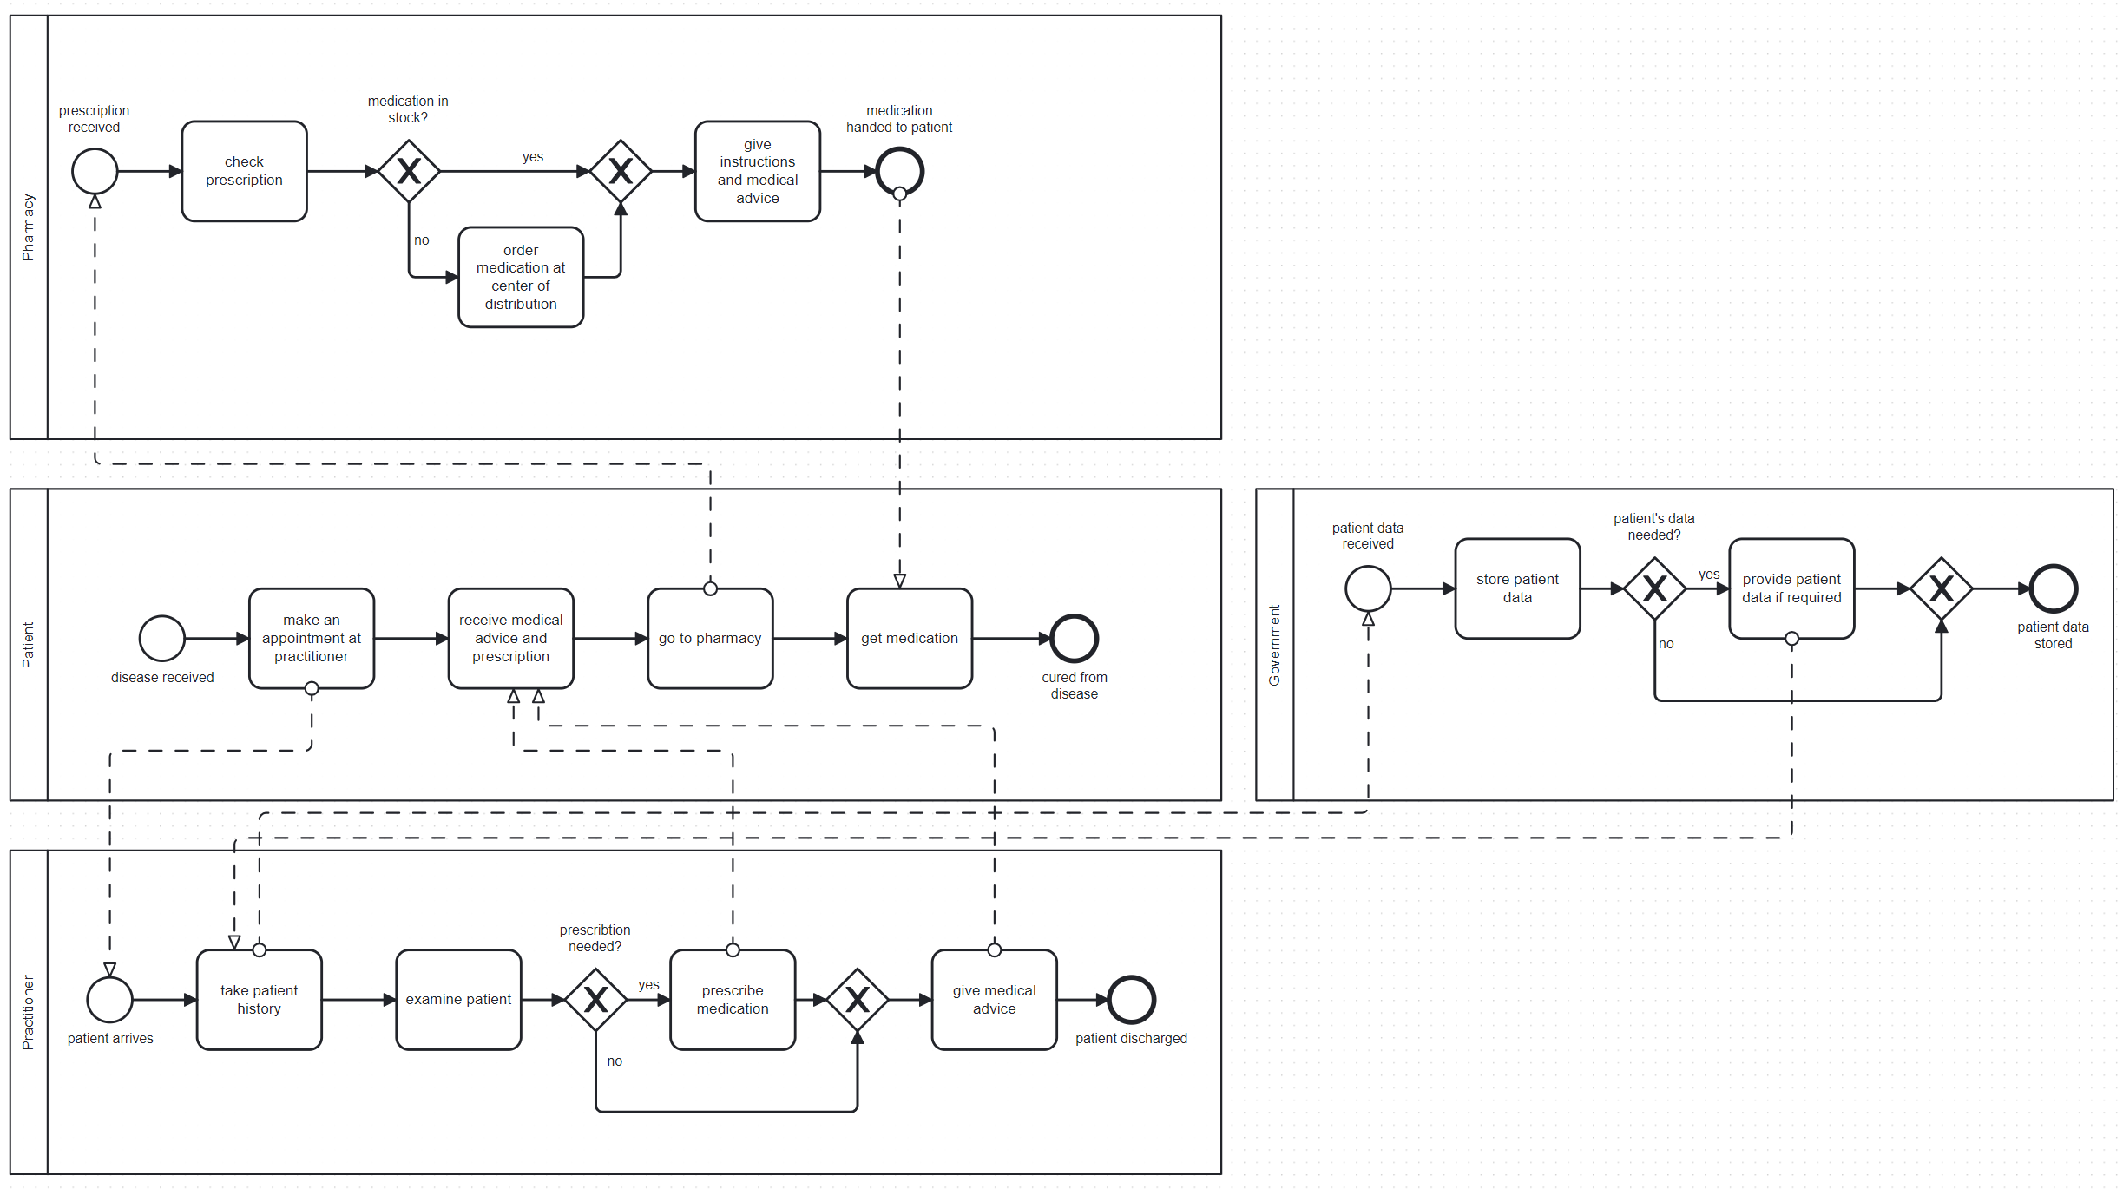
Example of current Process
Possible issues:
No obligatory interaction check
No check for double medication
No check if patient collects the medication
Handwriting of practitioner
No interaction of practitioner and pharmacy
Additional step to update EHR

Slide 4
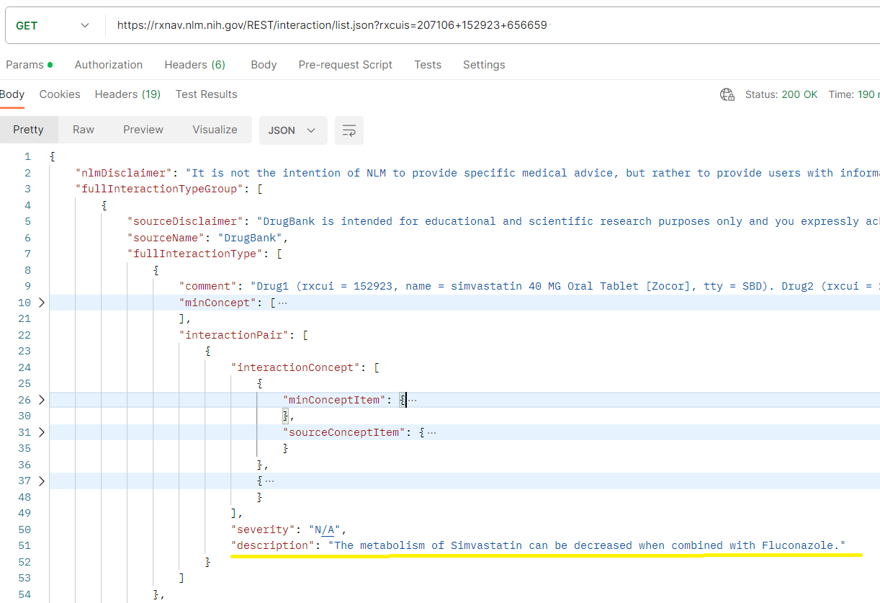




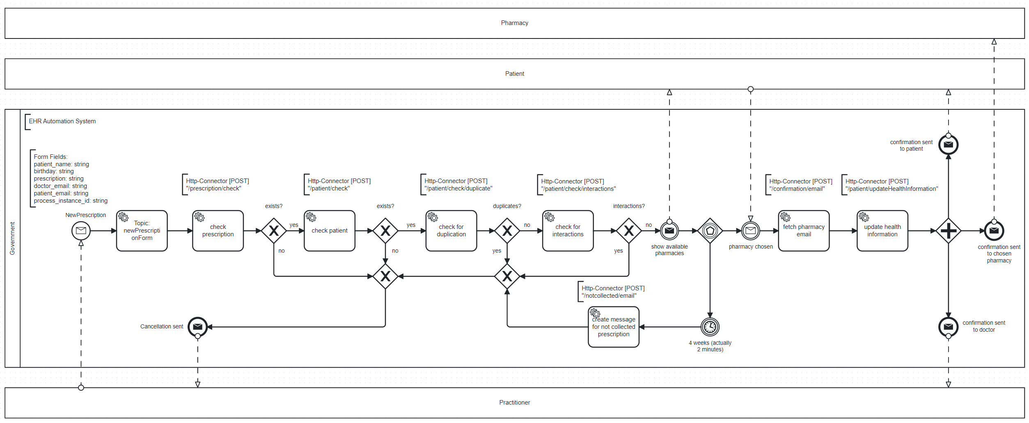
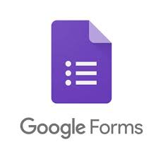




Our proposed Solution
Prescription exists?
Patient exists?
Duplicate prescription?
Interaction exists?
Fetch Pharmacy email
Update EHR-Database
Patient selects Pharmacy

Slide 5
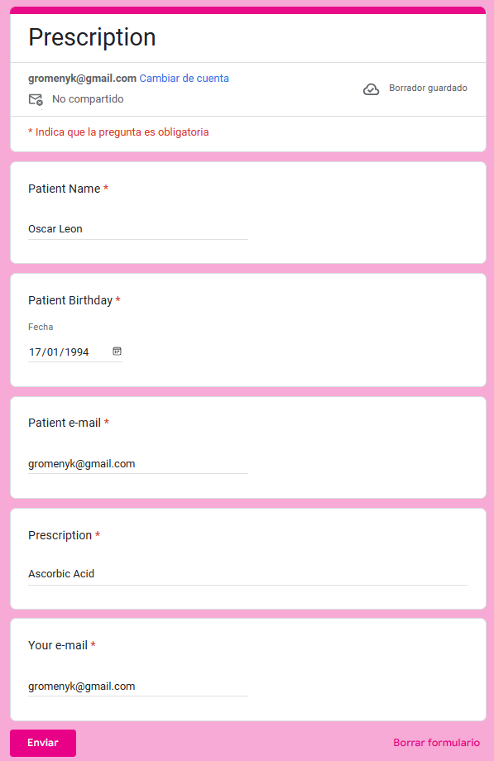
Demo

Slide 6
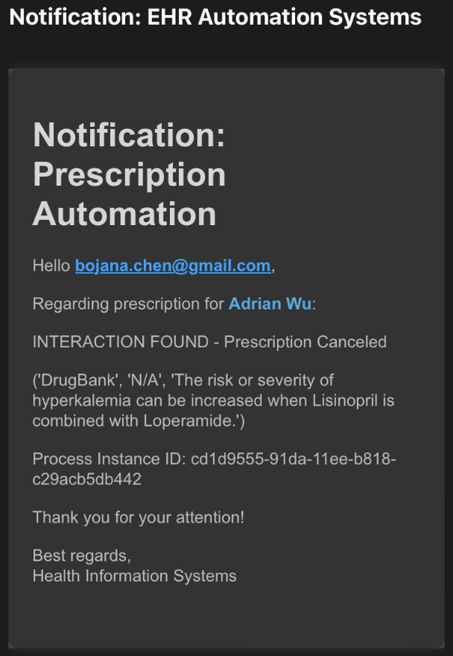
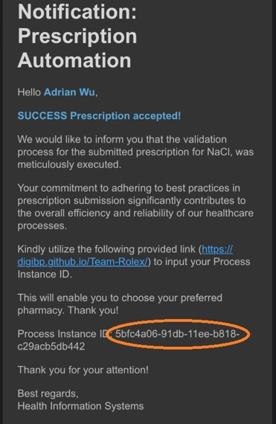
DEMO
Process Cancelation
Patient Notification

Slide 7
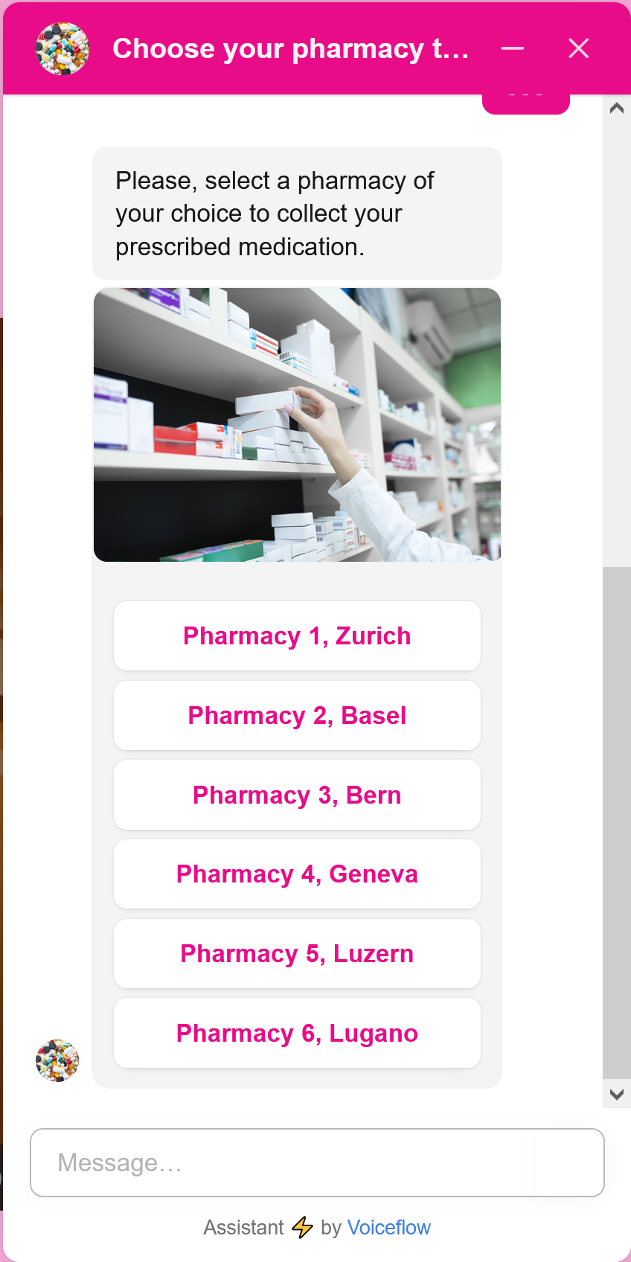
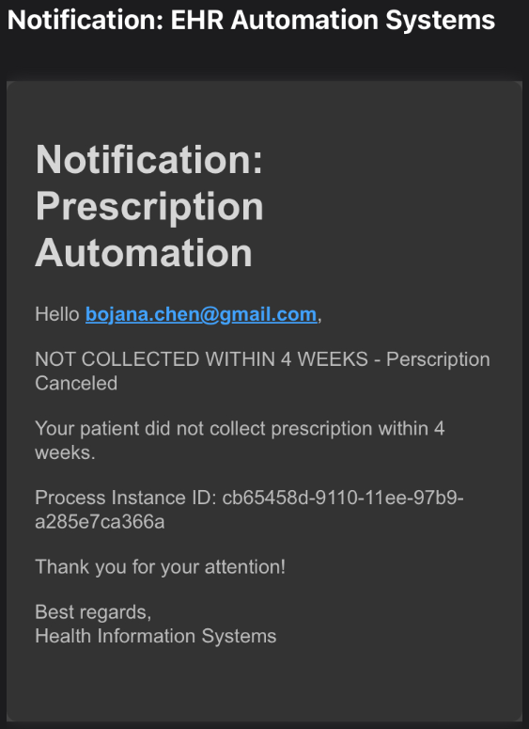
DEMO
Not Collected Notification

Slide 8
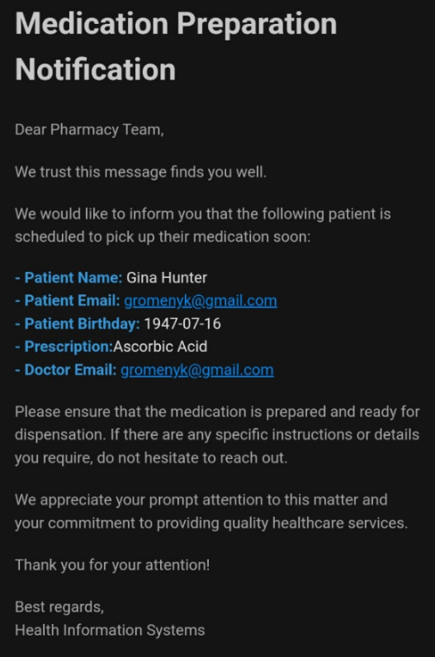
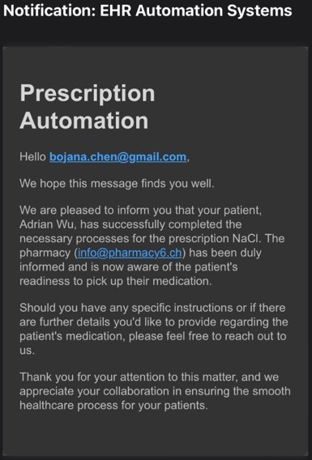
DEMO
Pharmacy Notification
Doctor Notification

Slide 9

DEMO
Patient Notification

Slide 10
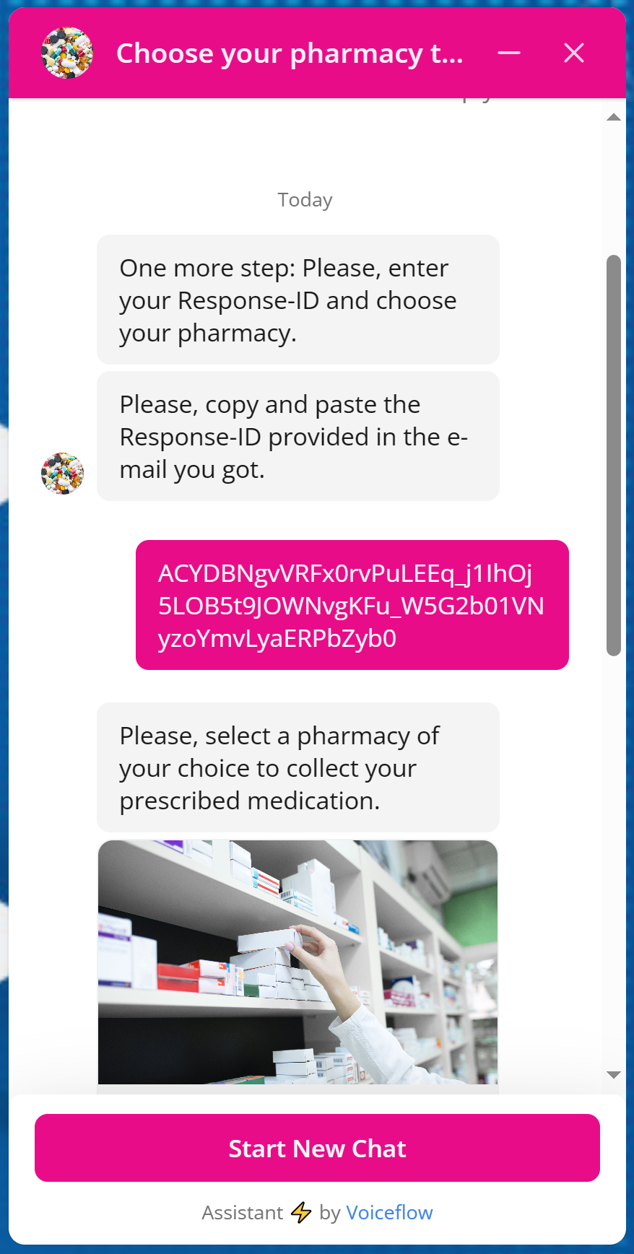
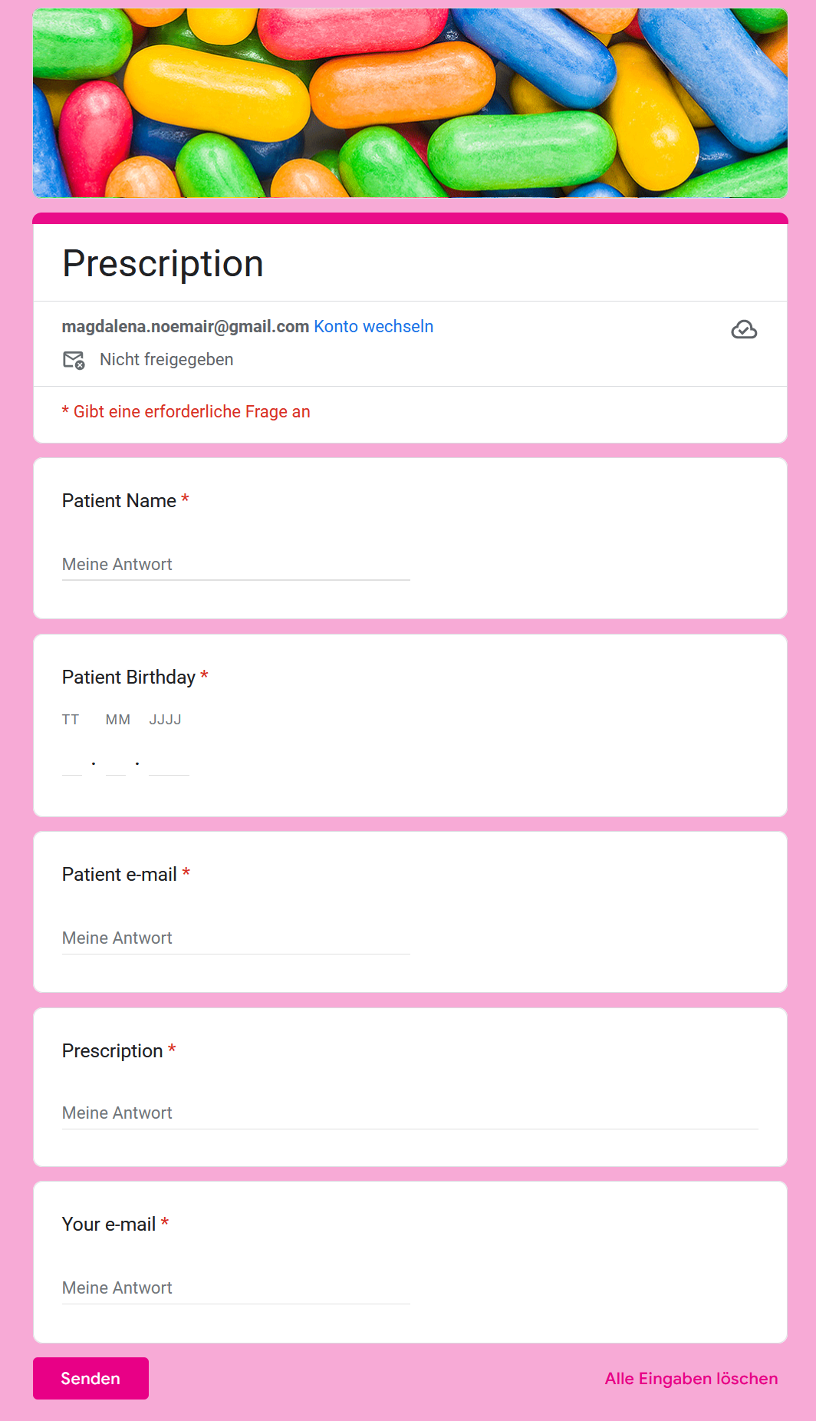
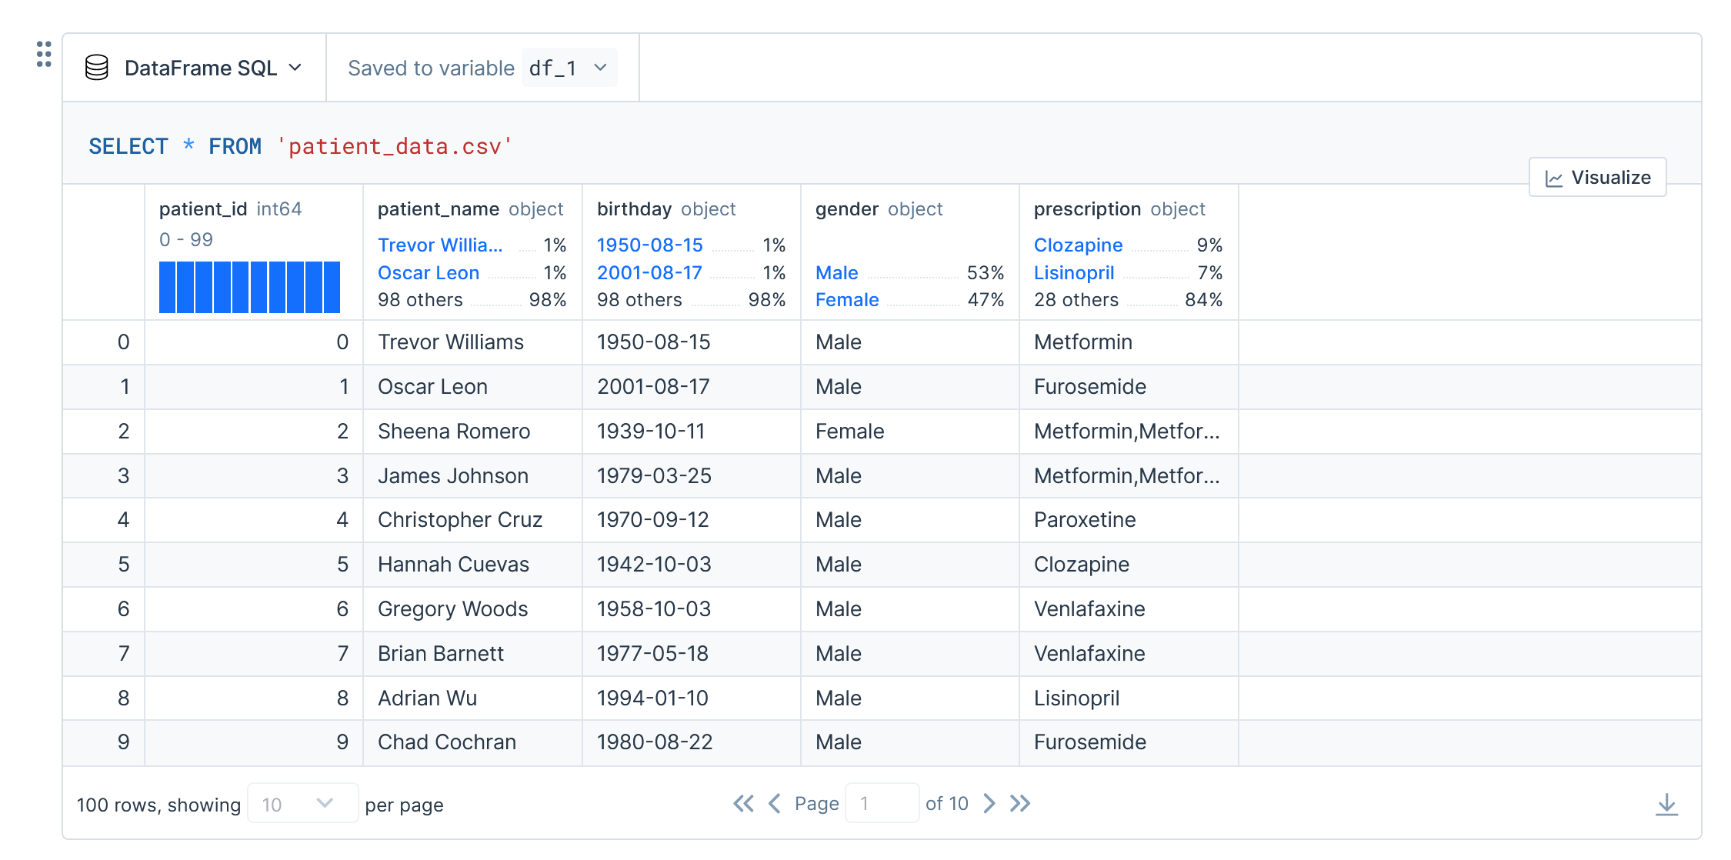
Benefits of our Process
Error prevention
All prescribed medications at a glance
Check for duplicate prescription
Check for drug interactions
Aborts workflow if errors found and alerts customers
Paperless
No paper necessary
Resource-efficient
User friendly
Only one document for doctors
Chatbot for human-like interactions for patients
Improved communication between participants

Slide 11
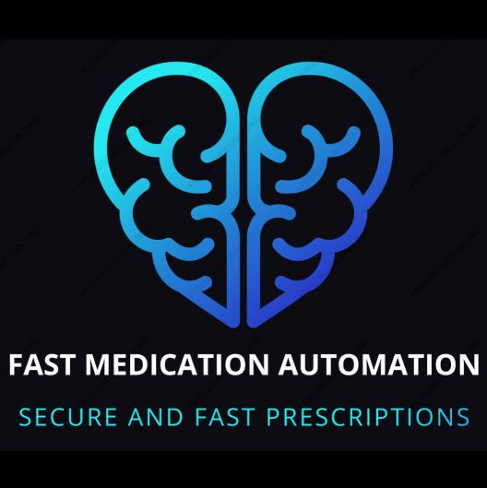

Fast medication automation
Secure and fast prescriptions!
Picture: https://www.freepik.com/free-vector/question-3d-effect-background_6209956.htm#query=questions&position=17&from_view=search&track=sph&uuid=ba74b47d-7045-44f2-b1d1-a17e8c526566">Image by pikisuperstar

Slide 12
Conclusion
Our solution addresses:
critical problem in the Swiss healthcare system by WRONGLY prescribed medications.
patient safety and simplified administrative tasks
complex processes by Revolutionizing Swiss healthcare system
Our solution enhances:
communication within multiple parties (Patient, Doctor, Pharmacy XY)
time limited fallback if prescribed medications are not picked up
medication interaction detection
on reducing administrative workload for stakeholders

Slide 13
Disclaimer
Data privacy laws are currently not met, the team is aware of this. Meeting data privacy was not in scope of this development project
Only patients registered to the EHR-system will be able to enjoy full service
Only active pharmaceutical ingredient should be prescribed

